Slide 1
Activation functions in Neural Networks
It is a mathematical function applied to the output of a neuron.
It introduces non-linearity into the model, allowing the network to learn and represent complex patterns in the data.
Without this non-linearity feature a neural network would behave like a linear regression model no matter how many layers it has.

Slide 2
Properties of Good Activation Function
Easily differentiable
Computationally inexpensive
Zero-centric in nature
Non-saturating in nature

Slide 3
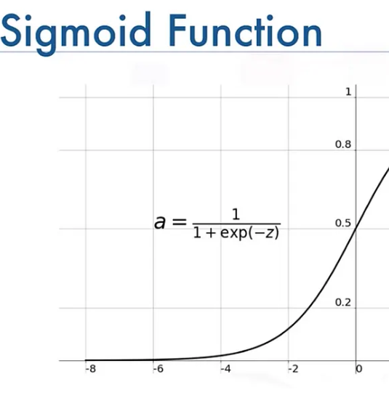
Non-Linear Activation Functions Sigmoid Function
Sigmoid Activation Function is characterized by 'S' shape. The output ranges between 0 and 1, hence useful for binary classification.
Pros:
Smooth gradient, prevents jumps in output value.
Useful in binary classification.
Cons:
Computationally expensive
Non-zero centric in nature can slow down convergence
Causes vanishing gradient problem, hence only used in the output layer

Slide 4
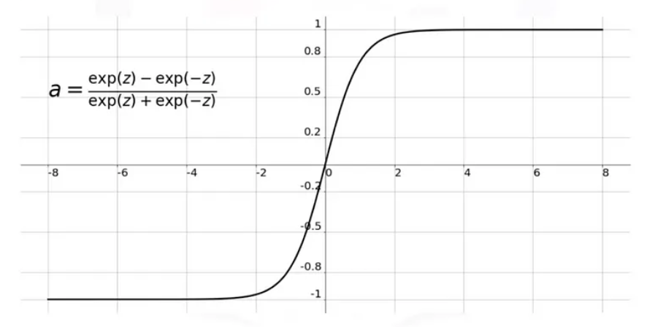
Tanh Function
The Tanh function is similar to the sigmoid but maps input values to a range between -1 and 1.
Pros:
Zero-centered output, faster convergence.
Smooth gradient.
Cons:
Computationally expensive
Causes the vanishing gradient problem.

Slide 5
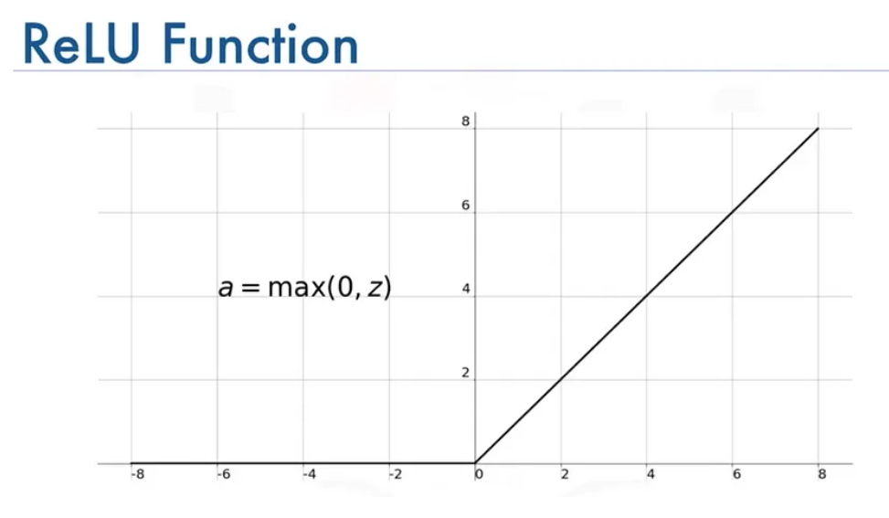
ReLU (Rectified Linear Unit) Function
ReLU activation is defined by A(x)=max⁡(0,x), this means that if the input x is positive, ReLU returns x, if the input is negative, it returns 0.
Value Range: [0,∞), meaning the function only outputs non-negative values.
Pros:
Computationally less expensive.
Mitigate the vanishing gradient problem
Used in intermediate layers
Cons:
May leads exploding gradient problem

Slide 6
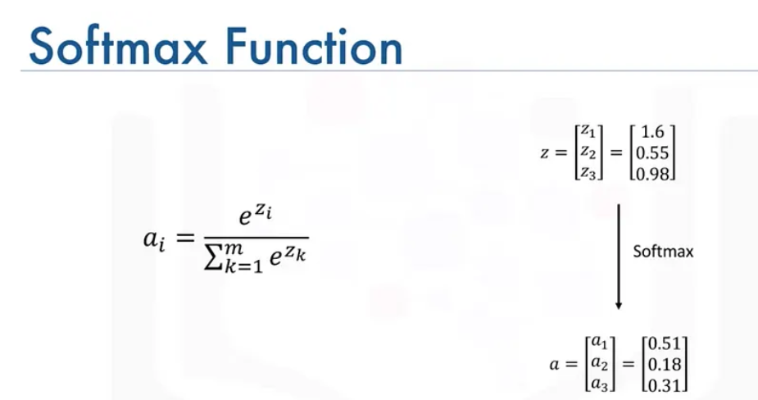
Softmax function
The softmax function is used primarily for multi-class classification. It converts raw scores into probabilities.
Pros:
Produces a probability distribution, making it ideal for Multi-class classification tasks.
Cons:
Can be computationally intensive for large outputs.

Slide 7

Mini-Batch Gradient Descent
How it works: Splits data into small batches and updates weights per batch.
Most widely used among the optimizers for neural network training.
Mini-batch gradient descent finally takes the best of both.
Common mini-batch sizes range between 50 and 256, but can vary for different applications.

Slide 8
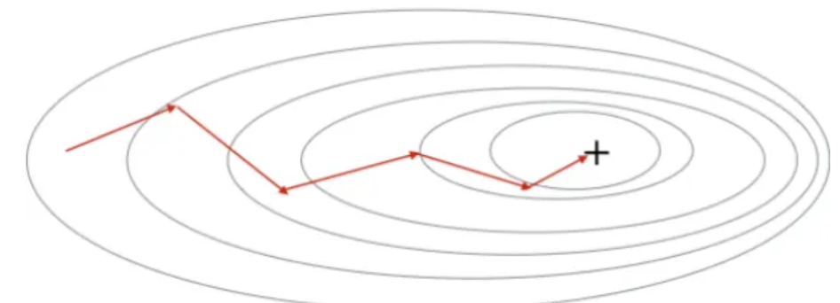
Mini-Batch
Advantages:
Faster convergence than batch.
Computationally less expensive than batch.
Support parallel computing or batch processing.
Relatively smoother gradient surface than SGD.
Disadvantages:
Extra complexity.
Selection of batch size.

Slide 9
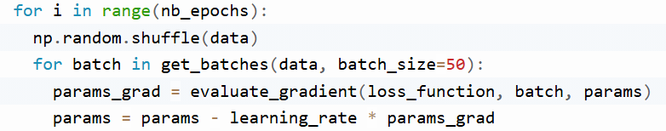
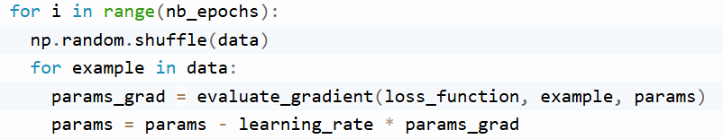
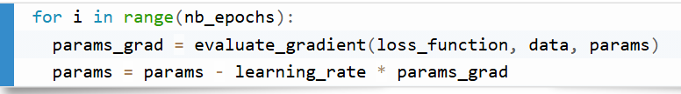
Implementation

Slide 10

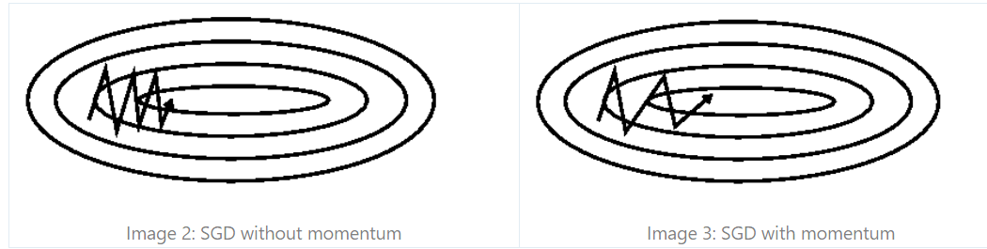
SGD with Momentum
Momentum is a method that helps accelerate SGD in the relevant direction.
dampens oscillations of SGD.
Momentum adds a fraction γ of the update vector of the past time step to the current update vector.
The momentum term γ is usually set to 0.9

Slide 11
SGD with Momentum
Advantages:
Relatively smoother error surface.
Faster convergence.
Disadvantages:
With momentum, it may miss the global minima

Slide 12
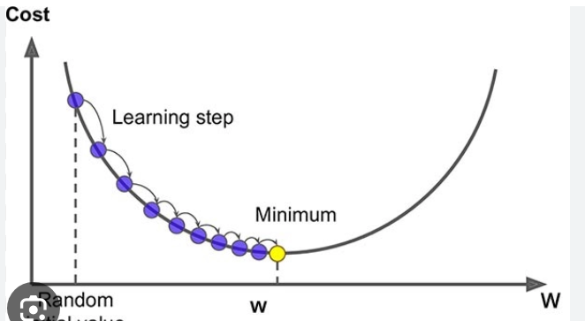
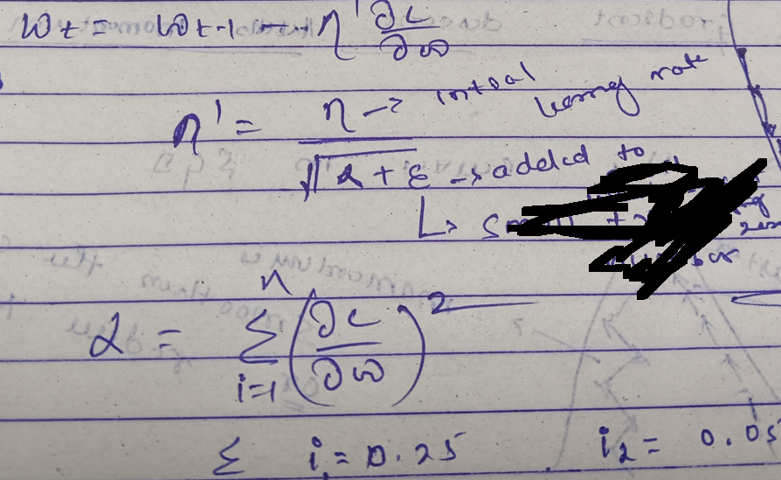
Adagrad (Adaptive Gradient Descent)
Its time decay-based gradient optimizer.
Working Procedure: it reduce learning rate at each iteration by some integer value.

Slide 13

Adagrad (Adaptive Gradient Descent)
Advantages:
Adaptive learning rate.
Faster convergence
Prevent overshooting and achieve global minima.
Disadvantages:
Causes aggressive learning decay.
Cause vanishing gradient problem.

Slide 14
Adadelta and RMS (Root Mean Square) Propagation
RMSprop and Adadelta have both been developed independently around the same time, and they both use an identical approach.
Designed to address Adagrad's radically diminishing learning rates.
RMSprop is an unpublished, adaptive learning rate method proposed by Geoff Hinton.
Adadelta and RMSprop are an extension of Adagrad that seeks to reduce the aggressive decreasing learning rate.
How it Work: Instead of accumulating all past squared gradients, Adadelta restricts the window of accumulated past gradients to some fixed size w.
It gives more priority to recent gradients while calculating the momentum.

Slide 15
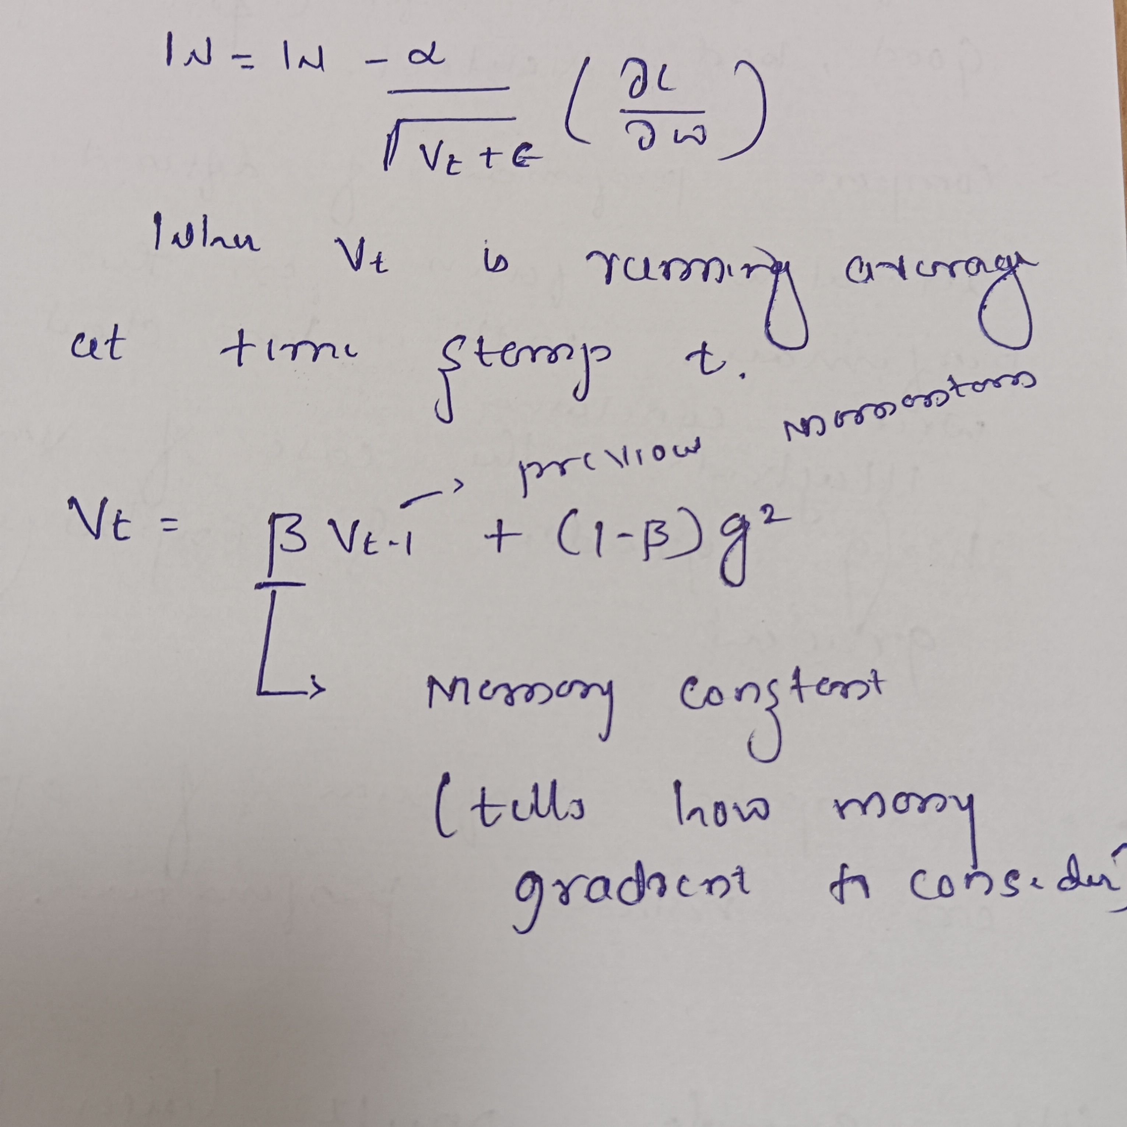
Adadelta and RMS (Root Mean Square) Propagation

Slide 16
Adadelta and RMS (Root Mean Square) Propagation
Advantages:
Achieves adaptive learning
Addresses the issue of undershooting and overshooting of Adagrad and SGD with momentum.
Solves the vanishing gradient problem
Disadvantages:
Computationally expensive.
Convergence is a little slower than momentum.

Slide 17
Adam (Adaptive Moment Estimation)
Its another method that computes adaptive learning rates.
Most powerful optimization algorithm, most widely used, and best suited to handle noisy data.
It combines the Velocity or momentum of SGD with Momentum with a running average of RMS prop.

Slide 18
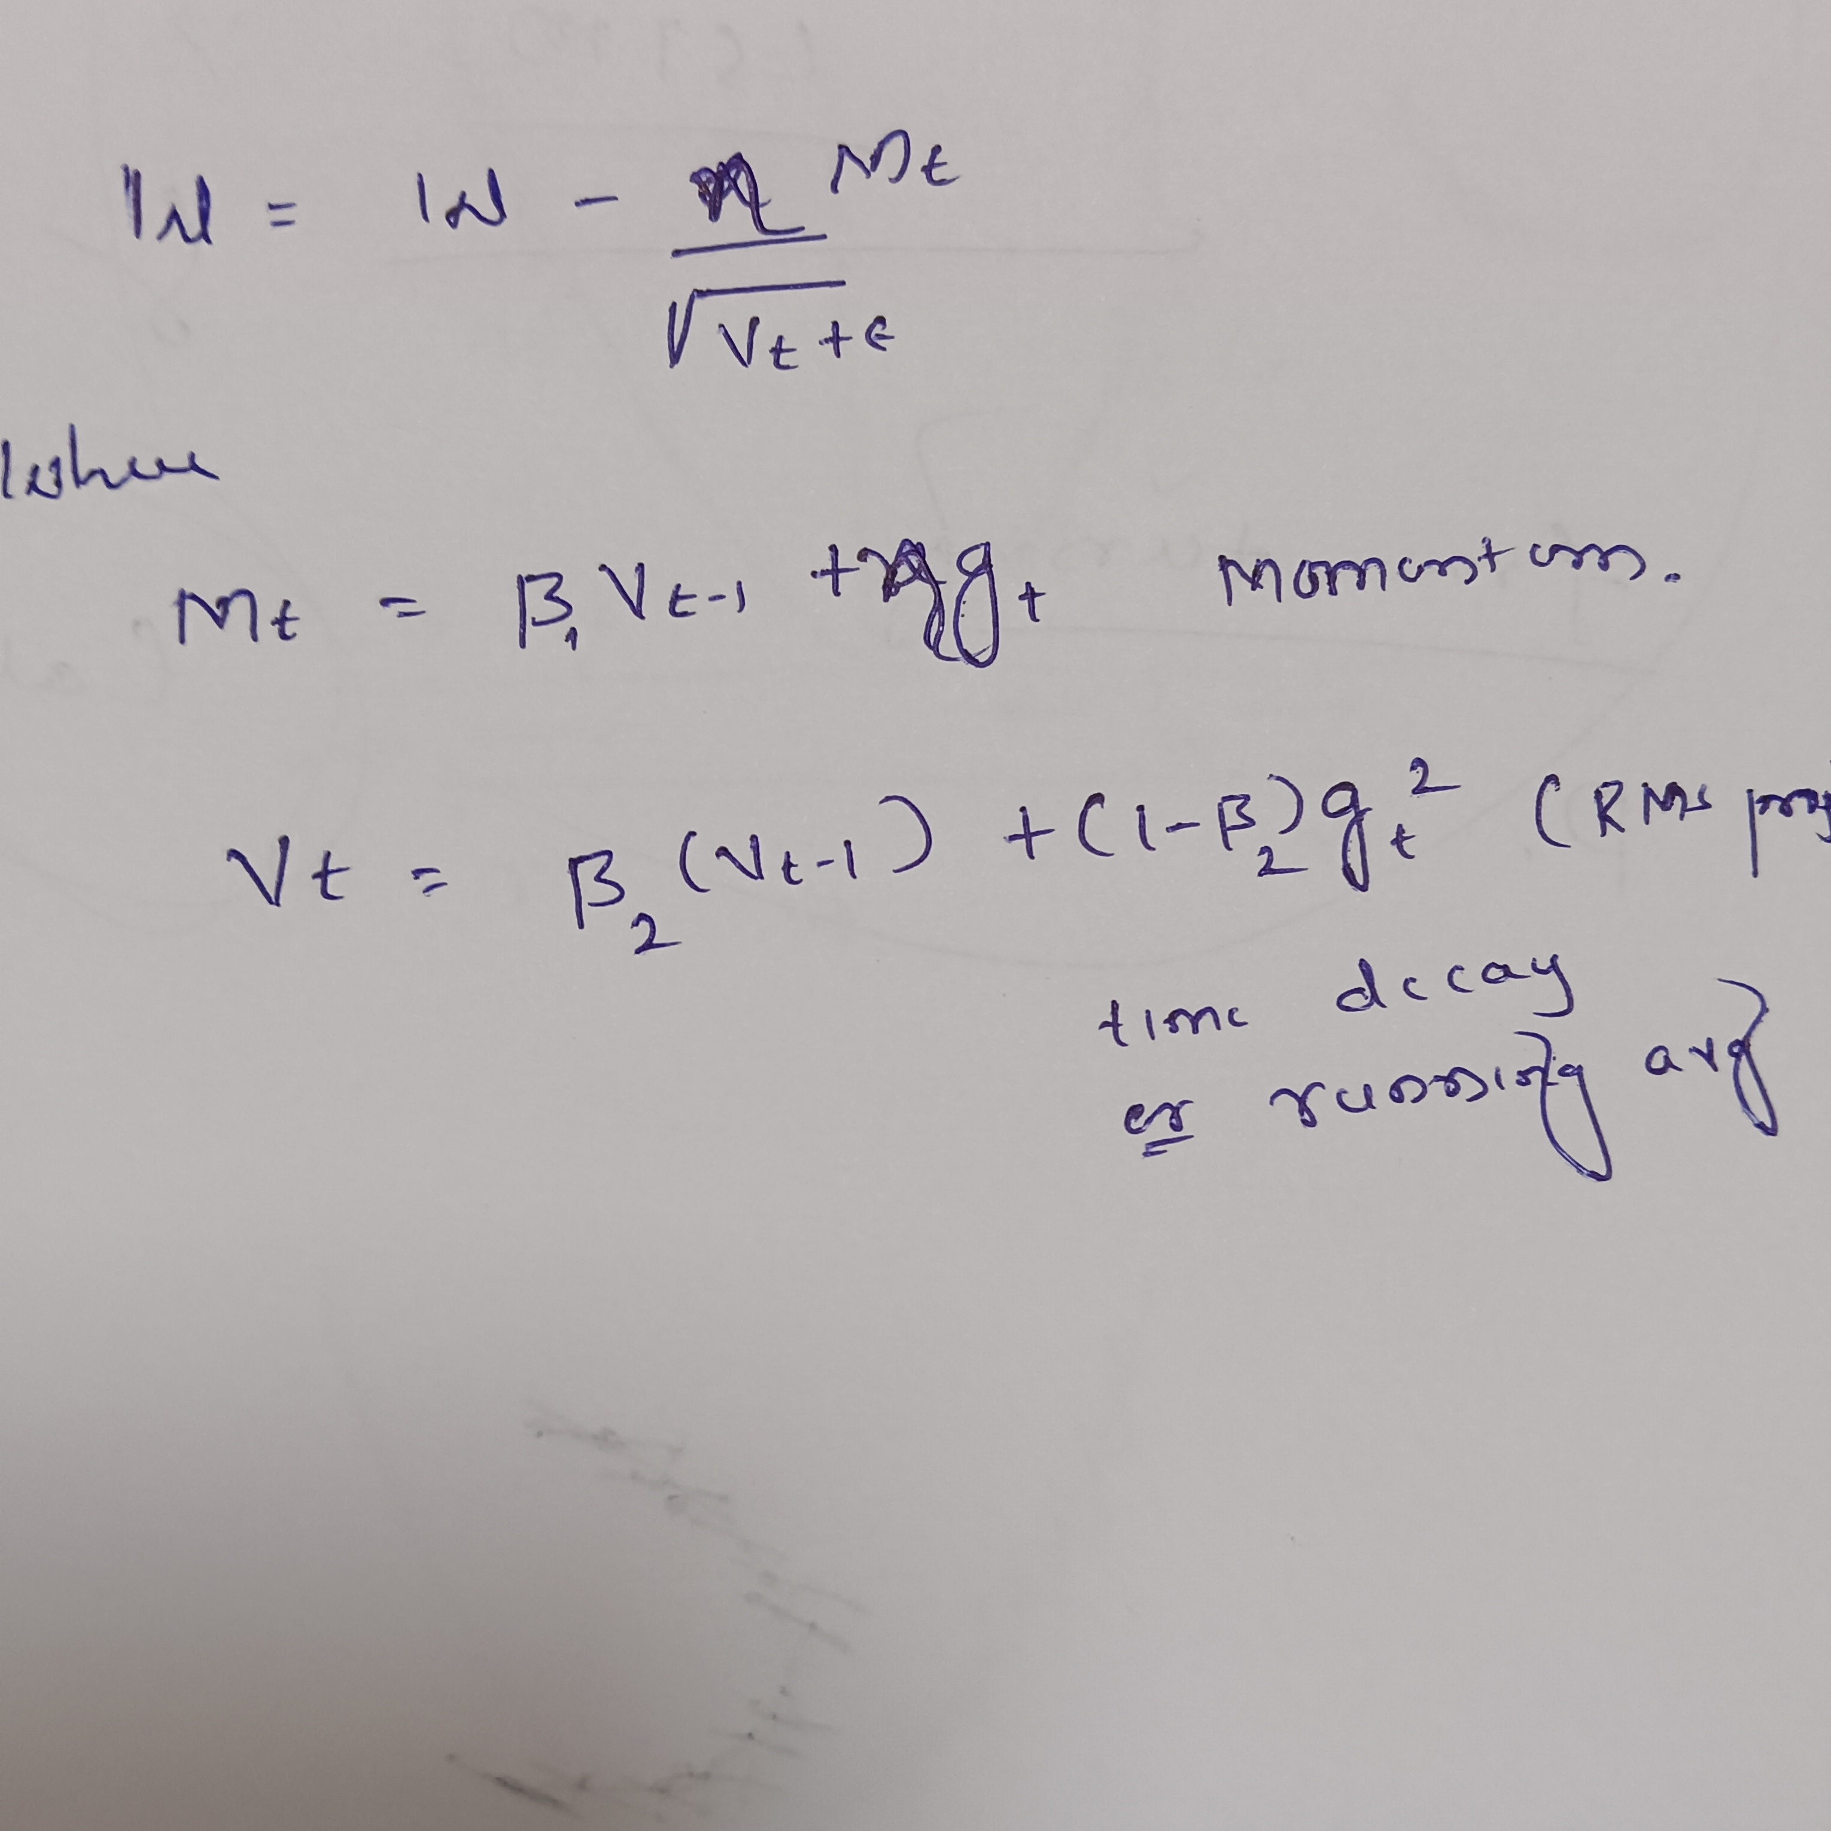
Adam (Adaptive Moment Estimation)

Slide 19
Adam
Advantages:
Fast convergence
Widely supported
Address vanishing gradient and exploding decay problems
Disadvantage:
Computationally more expensive.

Slide 20
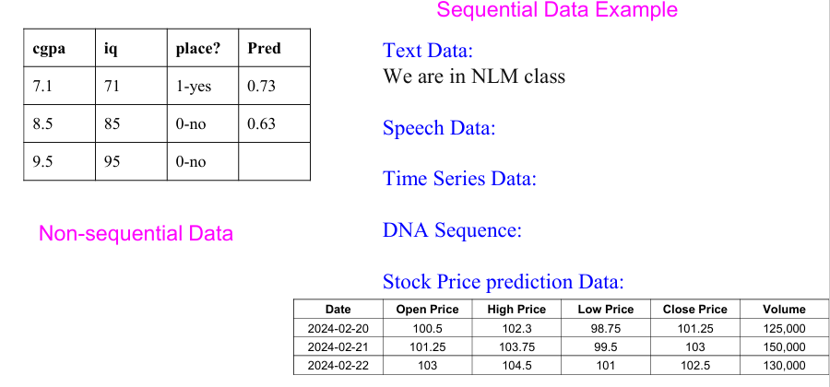
Limitations of ANN
Fail to handle sequential data.

Slide 21
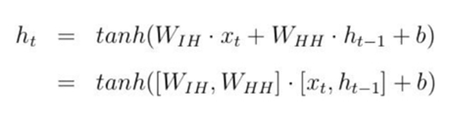
RNN(Recurrent Neural Network)
What is RNN??: Recurrent Neural Network(RNN) is a type of Neural Network where the output from the previous step is fed as input to the current step.
RNN retains the semantic meaning of the data, unlike ANNs, which treat every input independently.

Slide 22
Input to RNN

Slide 23
Input to RNN

Slide 24
Output from RNN

Slide 25
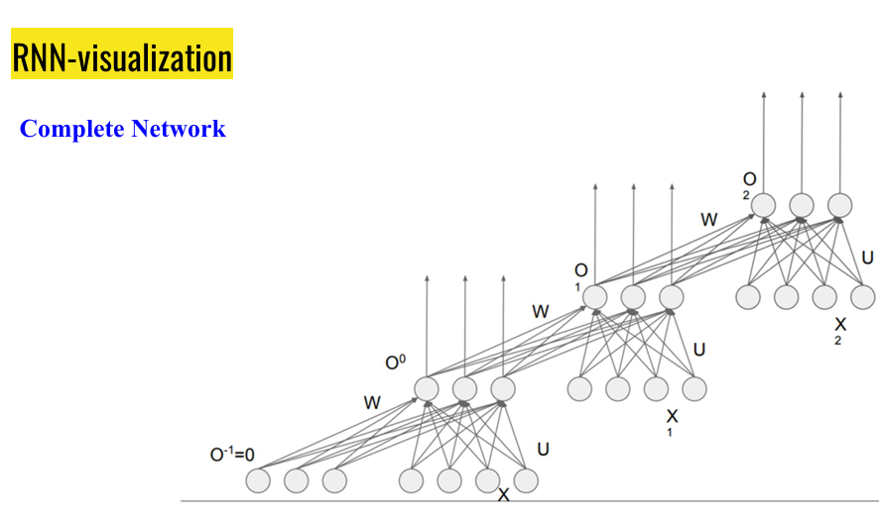
RNN unfolding through timestamp

Slide 26
